Slide 1
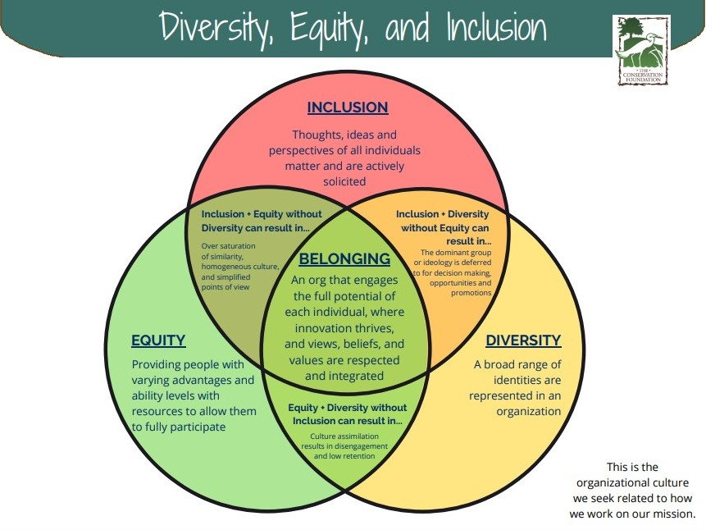
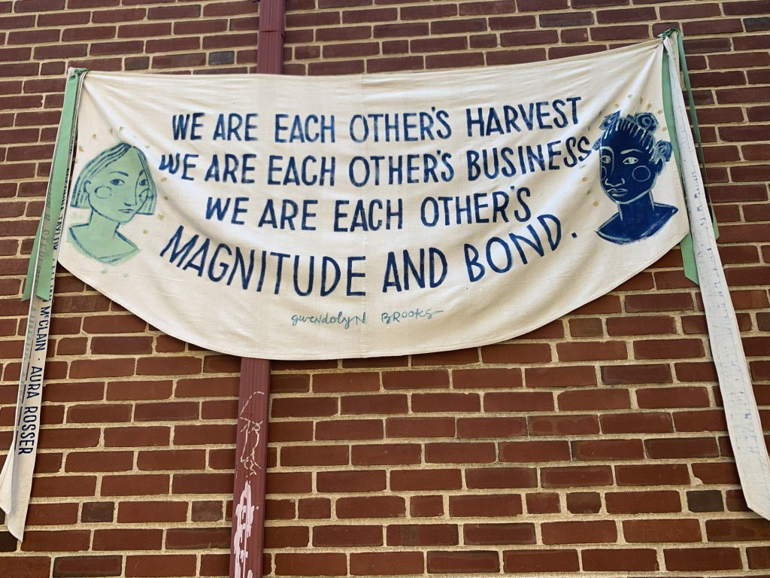
Creating an Inclusive Culture
Biomedical Graduate Studies
Dr. Sharon M. Ravitch
August 20, 2021

Slide 2
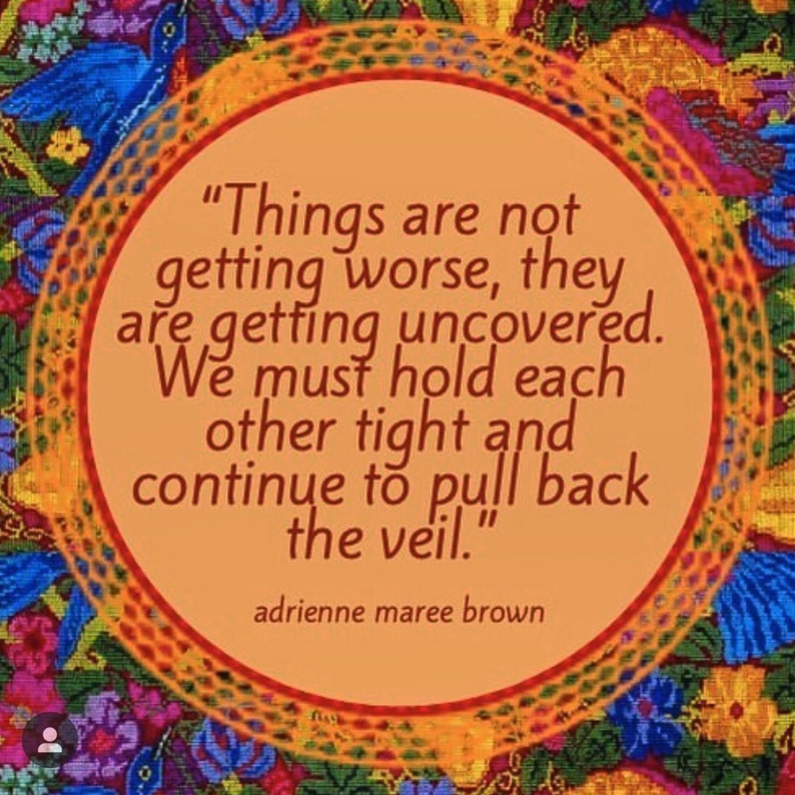
Challenges for Individuals from Underrepresented/ Marginalized Groups
Implicit Bias & Microaggressions
Stereotype Threat
Imposter Syndrome
Unwritten Rules
Intersectional Social Identities
Racial and Identity-Based Stress
Emotional Labor
Mentoring & Modelling

Slide 3
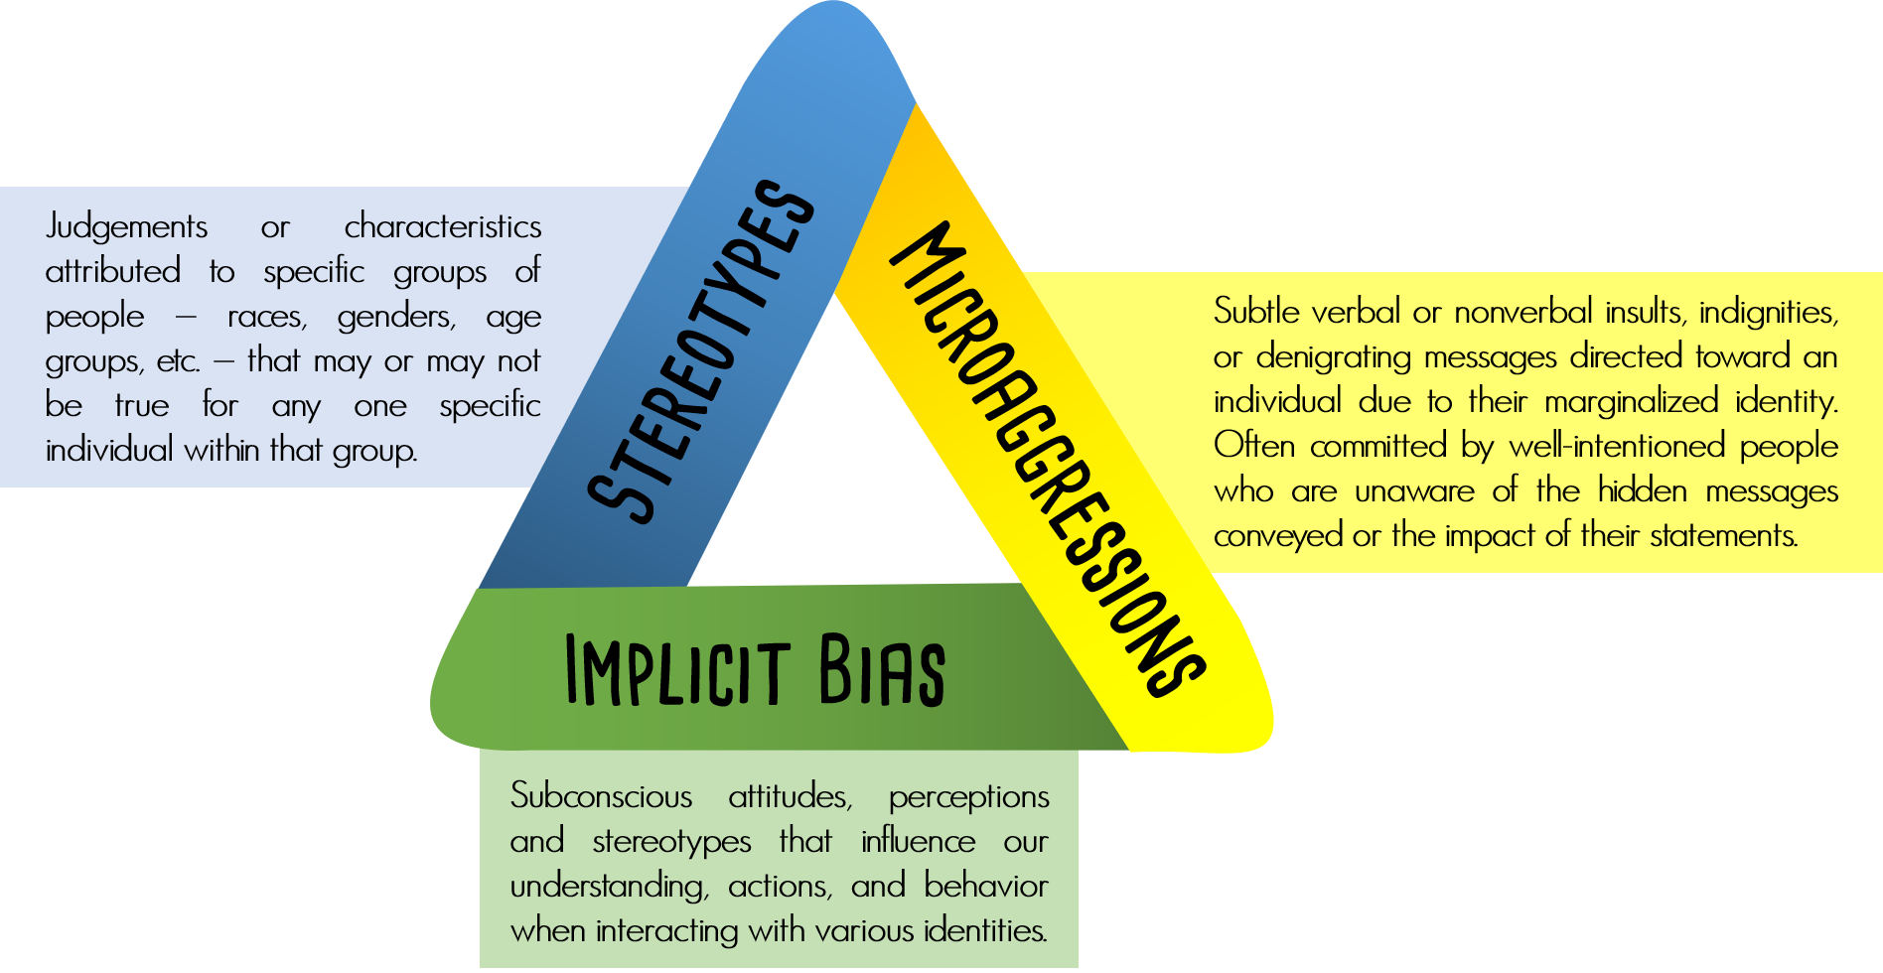
Implicit Bias
Implicit social cognition that shape our attitudes, stereotypes, our understanding, actions, assumptions, and decisions unconsciously
Activated involuntarily and without awareness or intention
Resides deep in our subconscious
Not accessible through introspection
Tends to support/enforce ingrained deficit-based thinking
Limits possibilities to see strengths and resources in inclusive ways
Notes:
SHERRY

Slide 4
Affinity – Preference for people who share qualities with you or people you like
Anchoring – Tendency to rely too heavily on first piece of information offered when making decisions
Attribution – Tendency to attribute other people’s successes to luck or help from others and attribute their failures to lack of skill or personal shortcomings
Attractiveness – Assumptions about people’s skills or personality based on physical appearance, favoring people who are more attractive
Confirmation – Selective focus on information that supports your initial opinion(s)
Conformity – Tendency to be swayed too much by the views of other people
Contrast – Assessment of two or more similar things by comparing them with one another rather than looking at their individual merits
Gender – Preference for one gender over the other
Halo – Focus on one particularly positive feature about a person that clouds your judgement
Horns – Focus on one particularly negative feature about a person that clouds your judgement
Common Types of Implicit Bias

Slide 5
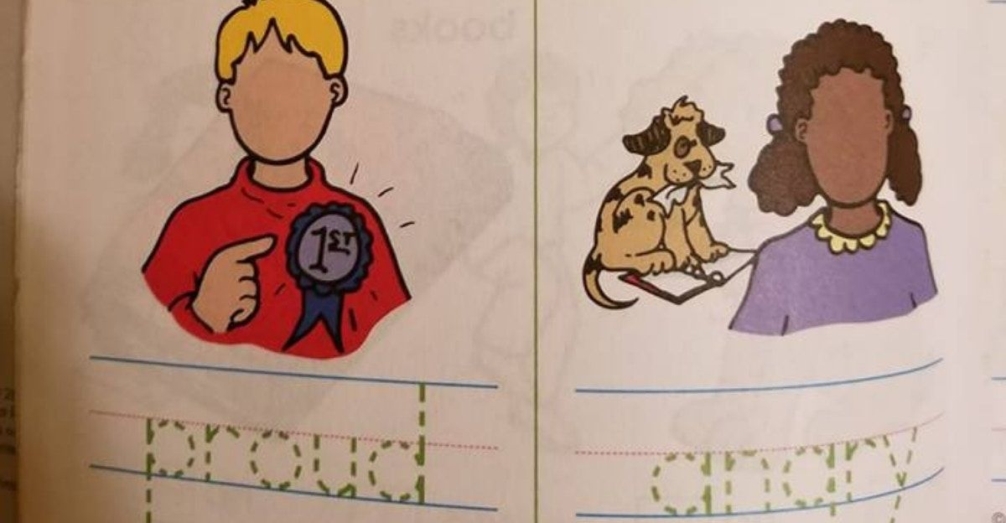
To address implicit bias:
  Become progressively aware of your implicit biases = your instinctual snap decisions on people as quickly as 30 milliseconds.
  Recognize that your life-long socialization creates blind spots.
  Recognize how it affects your work and organization.
  Understand how it influences how you interpret and respond to people.
  Learn how to recognize your own range of implicit biases.
  Raise awareness of implicit bias in your workplace.
  Practice intentional decision-making
  Encourage Inclusion
  Be an informed upstander
  Generates learning necessary to enact fair and inclusive policies and practices.

Slide 6
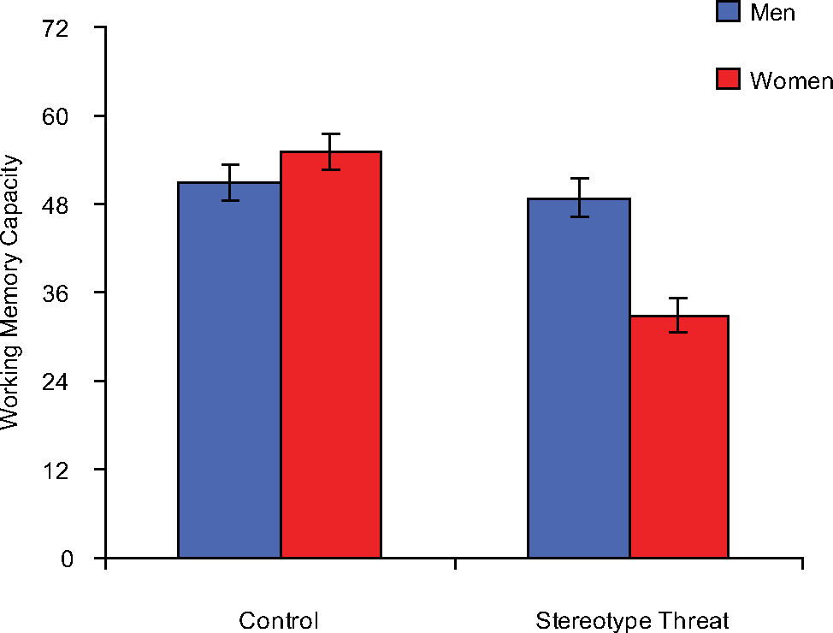
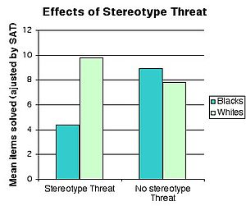

Stereotype Threat
Semantic Scholar
Stereotype threat is defined as a “socially premised psychological threat that arises when one is in a situation or doing something for which a negative stereotype about one's group applies” (Steele & Aronson, 1995).

Slide 7
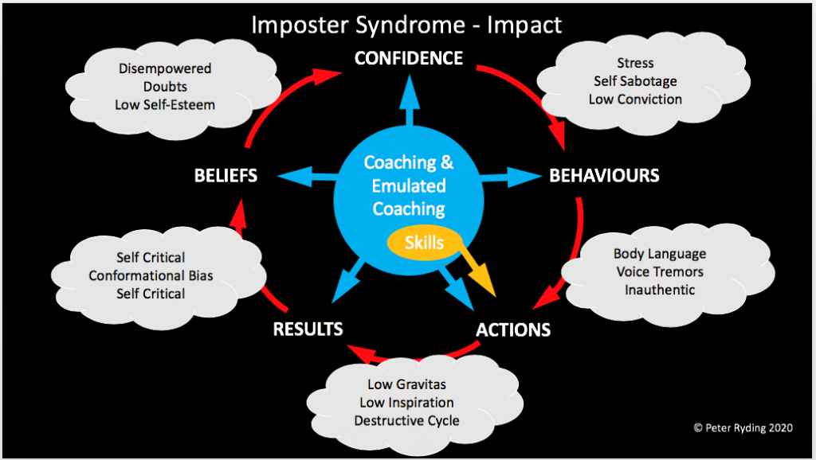
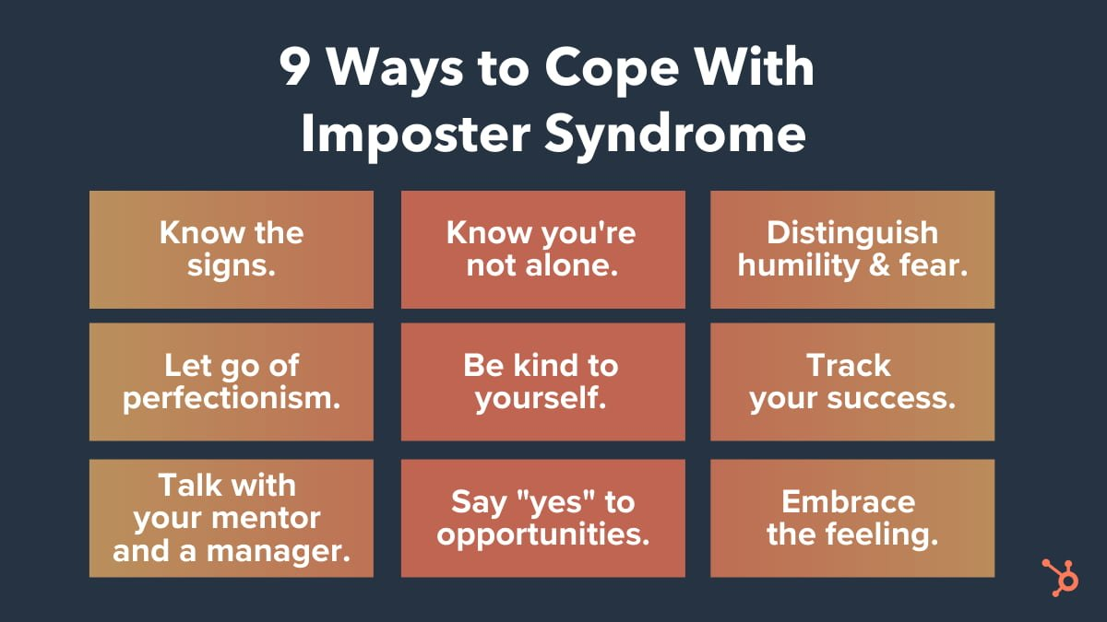

Imposter Syndrome

Slide 8
Unwritten rules
Invisible Logics and Communication Norms = Explicate and Excavate in Community
Unclear Expectations = Set Expectations
Institutional Culture is Visible and Invisible = Understand the culture of your institution
Determine how your values and expectations intersect with that of colleagues, department, and the institution's values, norms, and expectations = Dialogic Engagement
Mentoring = Engage in inquiry and ask for clarification

Slide 9
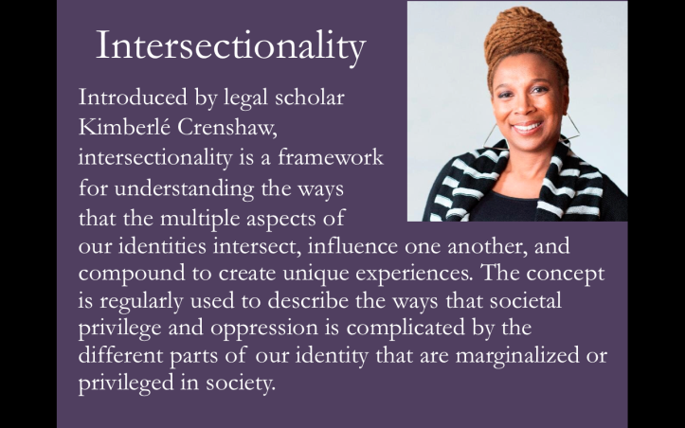
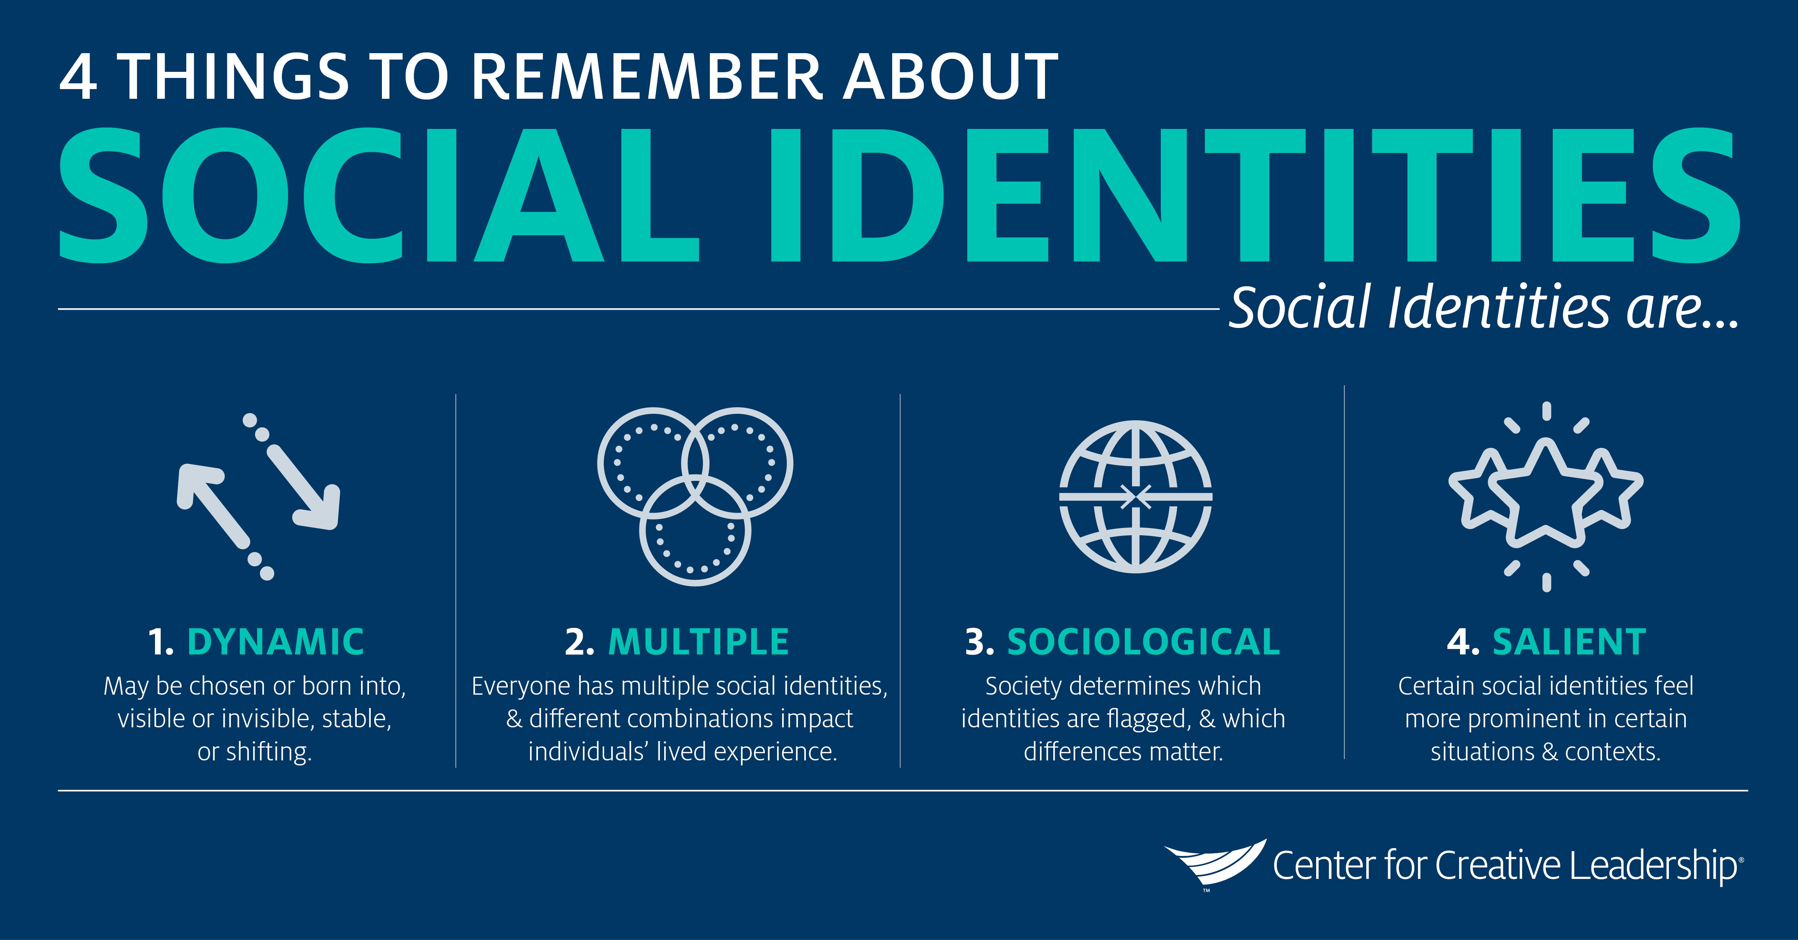

Slide 10
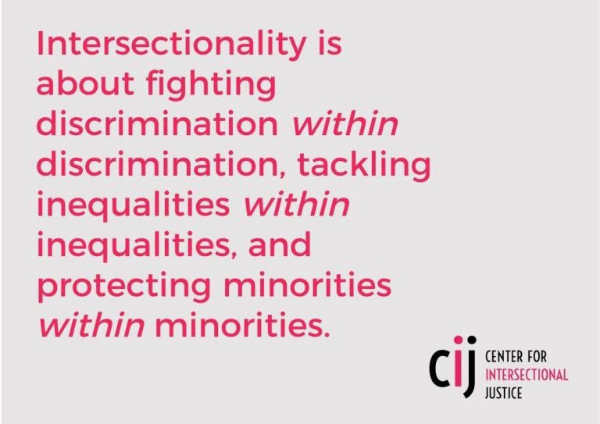
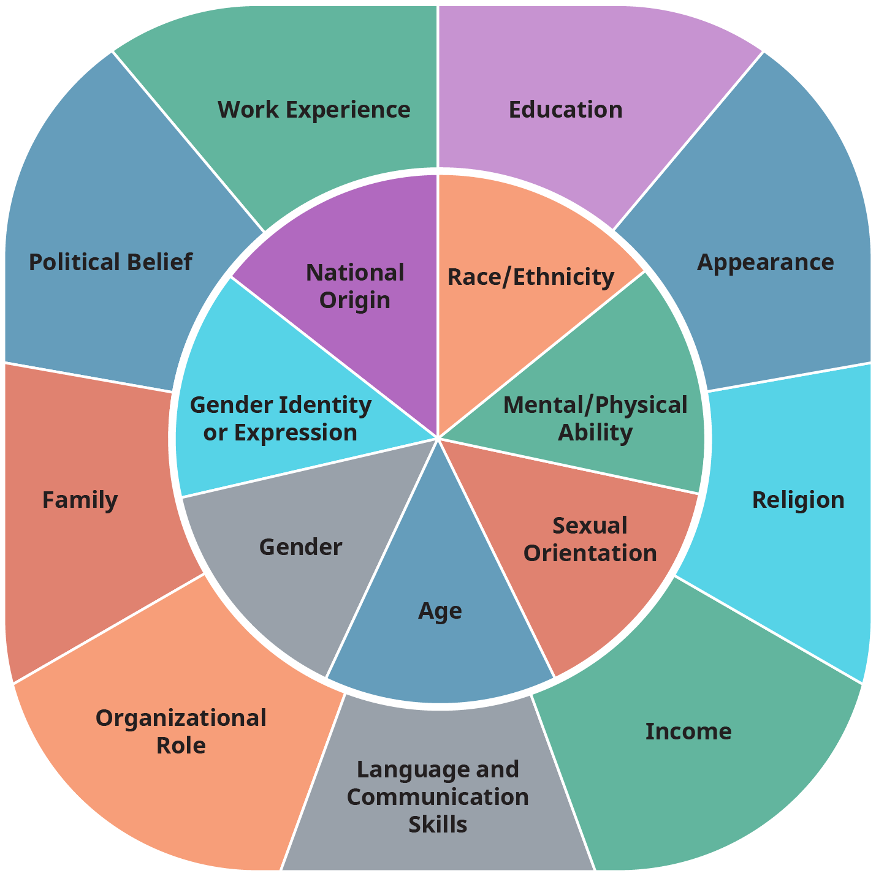
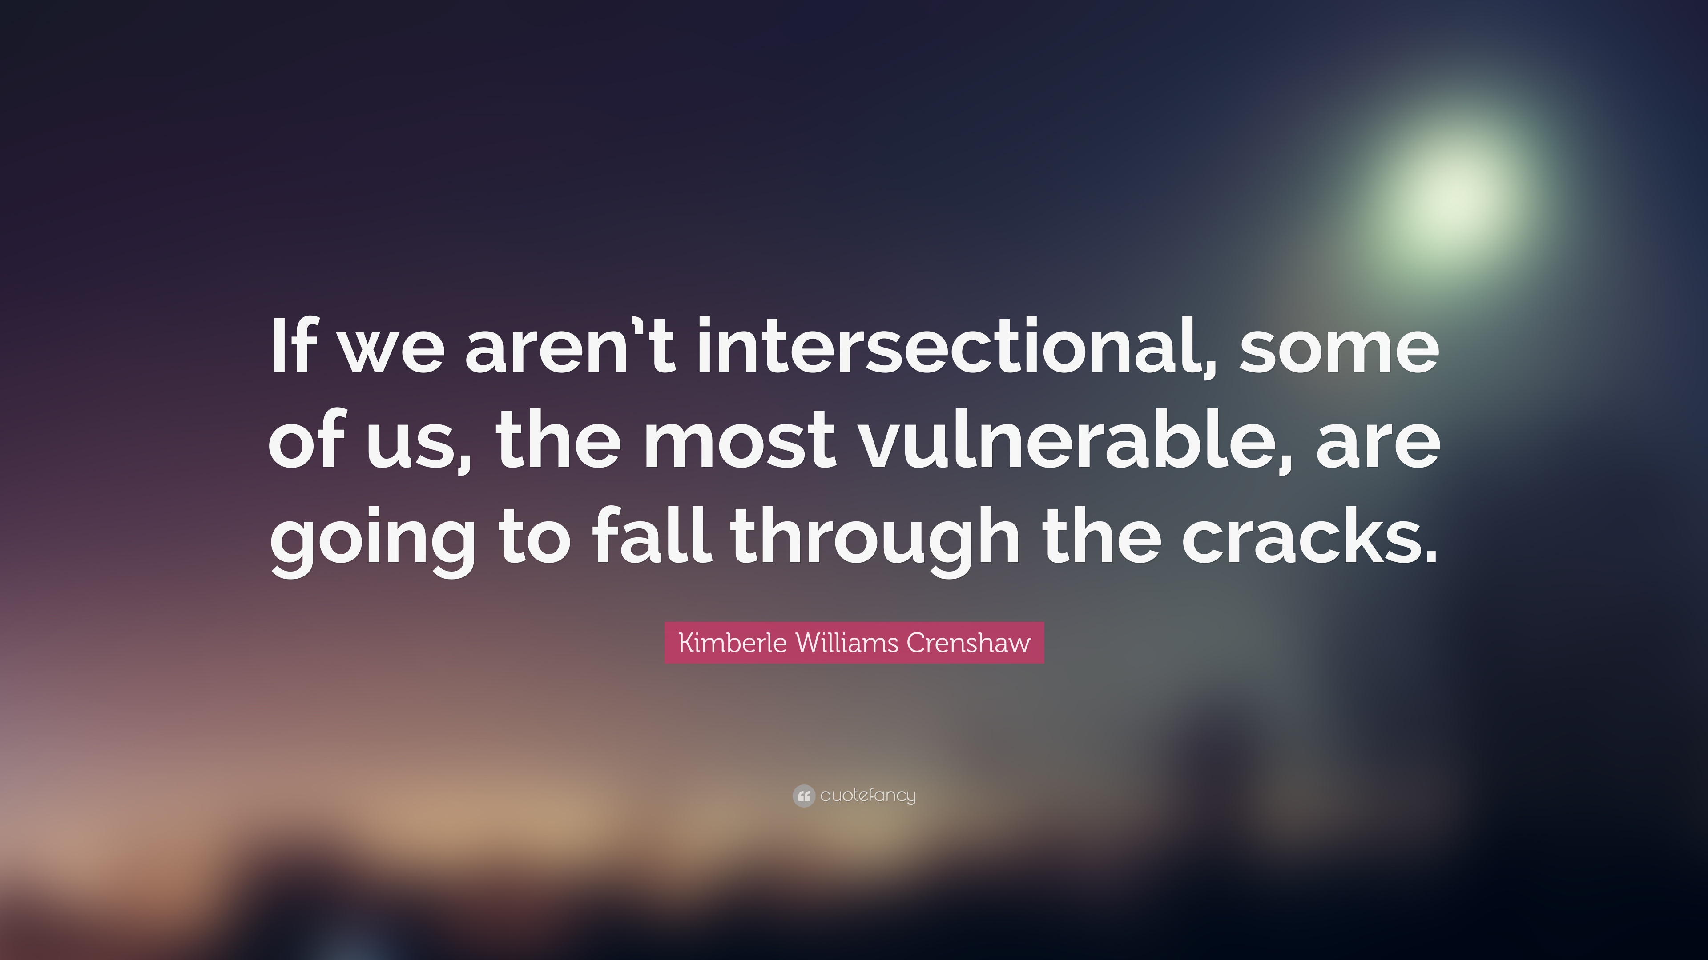

Slide 11
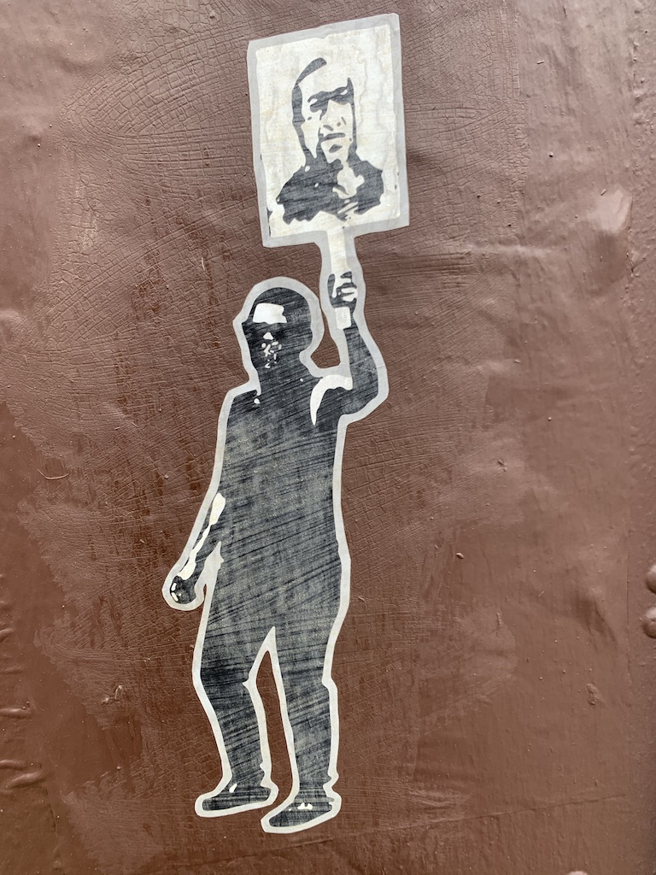
Racial and Identity-based Stress
Racial microaggressions are subtle but powerful slights, insults, and demeaning occurrences in social places that are experienced by people of color and that accrue over time to eclipse experience, trust, and wellbeing. (Sue, 2009)
Vicarious racial stress is the observation of racial microaggressions in the work environment. It is coupled with a feeling of powerlessness to made a difference or to interrupt or fearful of confronting the perpetrator(s) who often have no awareness of their impact.
White people have been taught that racism is a moral failing and that we must defend ourselves when we are called out rather than engaging in “humble inquiry.” White fragility, grievance, and preoccupation with intention rather than impact continues to hurt people of color and their trajectories.
“The pressure to maintain this superficial veneer
of civility and courtesy
really hurts us in having difficult conversations.” (Coleman, 2013)

Slide 12
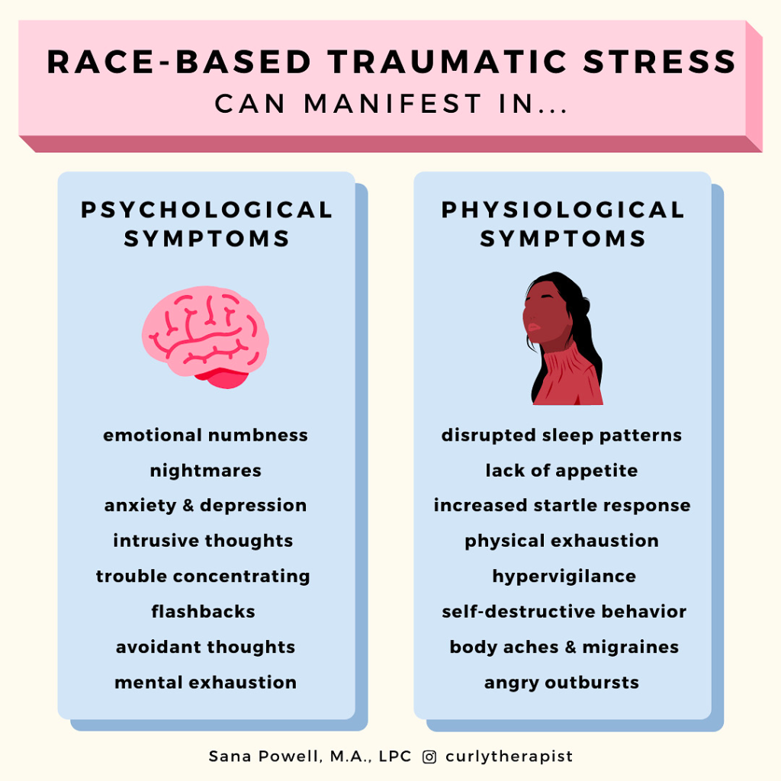
Racial Stress,
Racial Suppression,
Racial Fatigue
“Often, due to my position, it is perceived as merely the lens through which I see the world; my position has led others to decide that I am simply a hypercritical or pessimistic person (which couldn't be farther from the truth).”
“Bringing up an ‘issue’ makes one seem like a troublemaker. I have brought issues, only to be met with raised eyebrows. It is very frustrating. It is like a scene in “The Emperor’s New Clothes.” No one wants to point the finger, and if you do, you’re deemed ‘mistaken.’ There is a huge sense of denial going on.”
(Coleman, 2013)

Slide 13
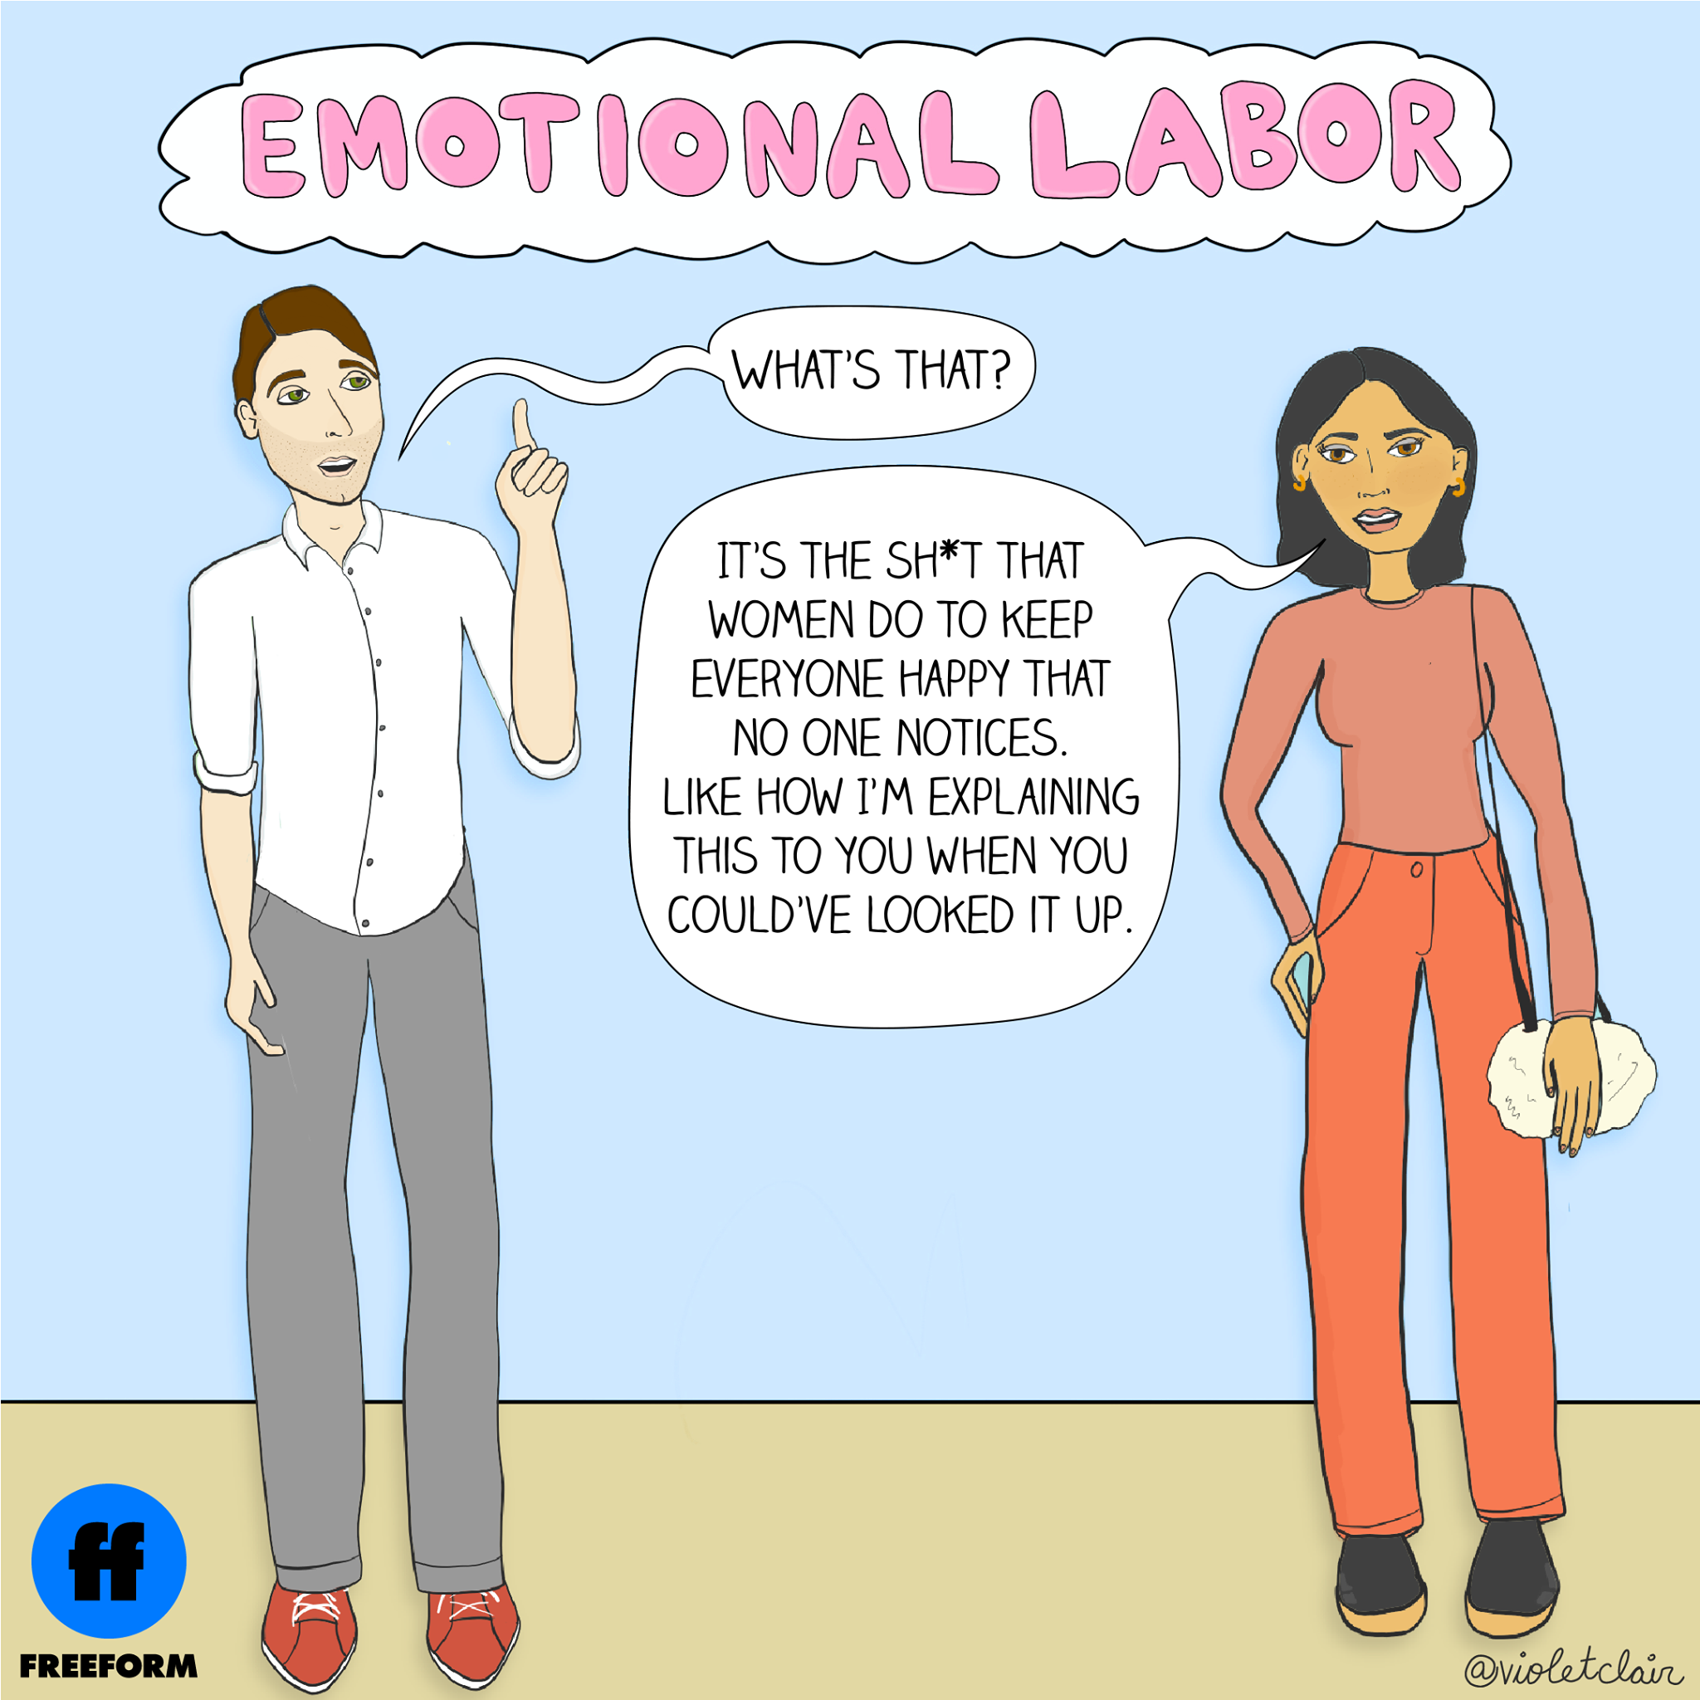
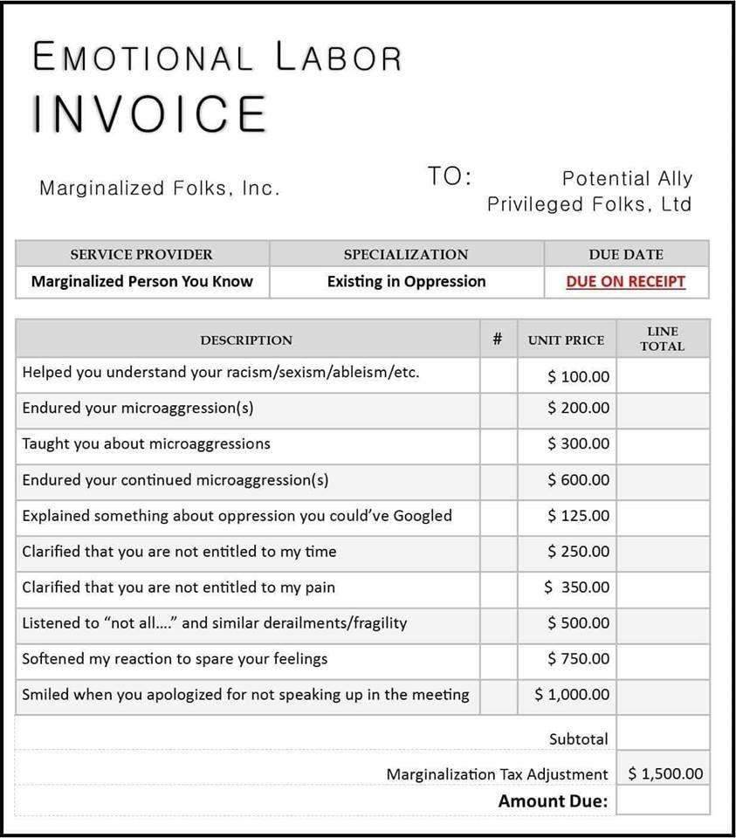

Slide 14
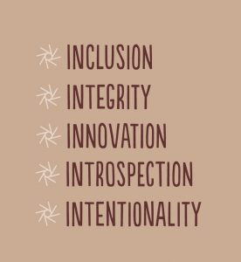
5 Reflexive Scans to Identify Your Own Invisible Logics
Emotional labor scan: Am I aware of emotional labor (the ways that people must manage certain emotions at work in relation to hierarchy), both my own and that of others? Am I causing emotional labor demands from people around me? Am I unintentionally creating the conditions for others to withhold their authentic reactions and ideas?
Power and norms scan: What are the norms of communication in this class/meeting? Who decides these norms? Who do they benefit? What happens when they are challenged and how does that shape others’ behavior?
Invisible logics scan: What invisible logics shape communication in this space? Which logics are spoken, and which are tacit? What shapes these logics?
Deflection scan: Am I deflecting, reacting from shame, being defensive, or resisting hearing truths that feel threatening to my identity or sense of self? Do I feel overly entitled to personal comfort in classroom discourse?
Societal trope scan: Am I sufficiently aware of societal tropes (for example, the angry Black woman)? Am I noticing how these stereotypes make people feel frustrated and dehumanized in real time? How am I making sense of this? How am I showing up in this?
(Ravitch, 2021)

Slide 15
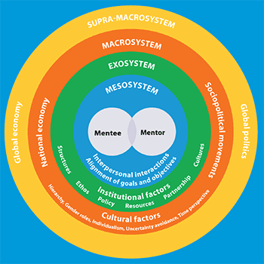
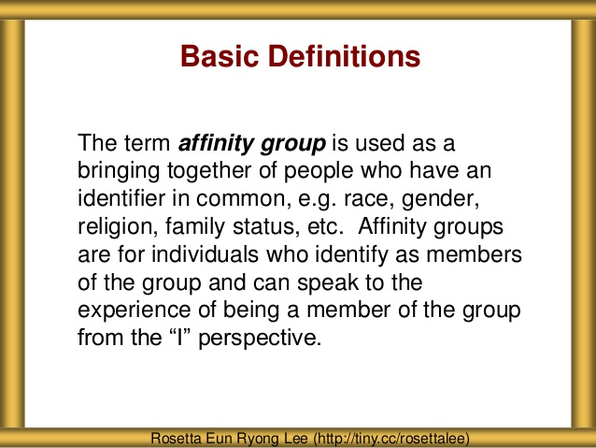
What supports fruitful identity & equity work?
High-quality mentoring relationships can create brave spaces that help us stretch our capacity to live in the learning and growth zones when it comes to anti-racism and intersectional equity.
Relational Resources
    Affinity Groups
    Cross-Identity Relationships
    “Backstage Processing” Relationships
    Establish a formal mentoring team
    Seek out informal mentoring opportunities
    Solicit constructive feedback
    Participate in peer-mentoring activities
  Self-Resources
    Motivate self to examine identity dynamics
    Know your biases, strengths, weaknesses and work to address them
    Choose to educate self/others instead of internalizing external bias
    Seek out engaged mentorship
    Ask for help
    Get Involved
    Be inclusive

Slide 16
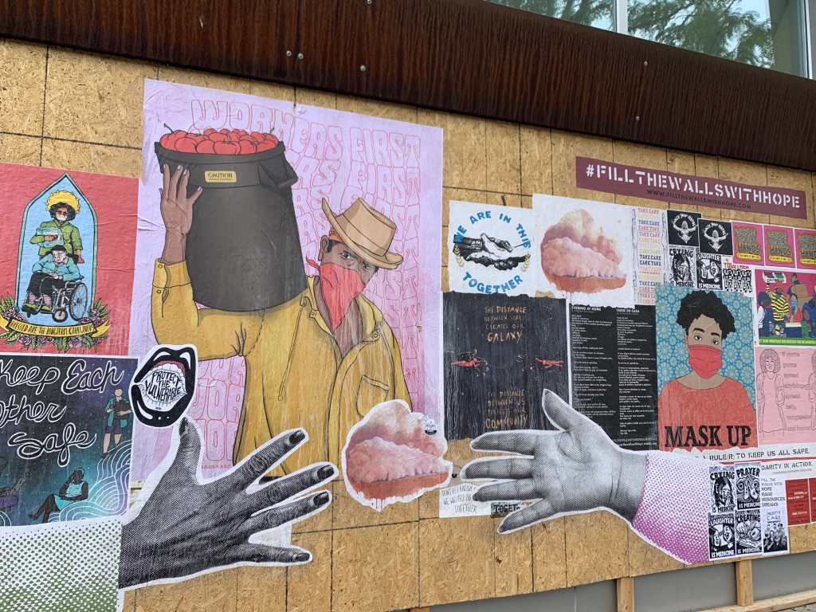
pour. spill. give. pour. spill. give.
no matter
no matter
and in the wake of
judgement and
ridicule and
pressure to
unbecome
stick to The Giver, @AdrianMichael
your bones
your stars
your deepest inner
and
always
always always
share
who you are
lift your voice
even if it trembles.
`

Slide 17
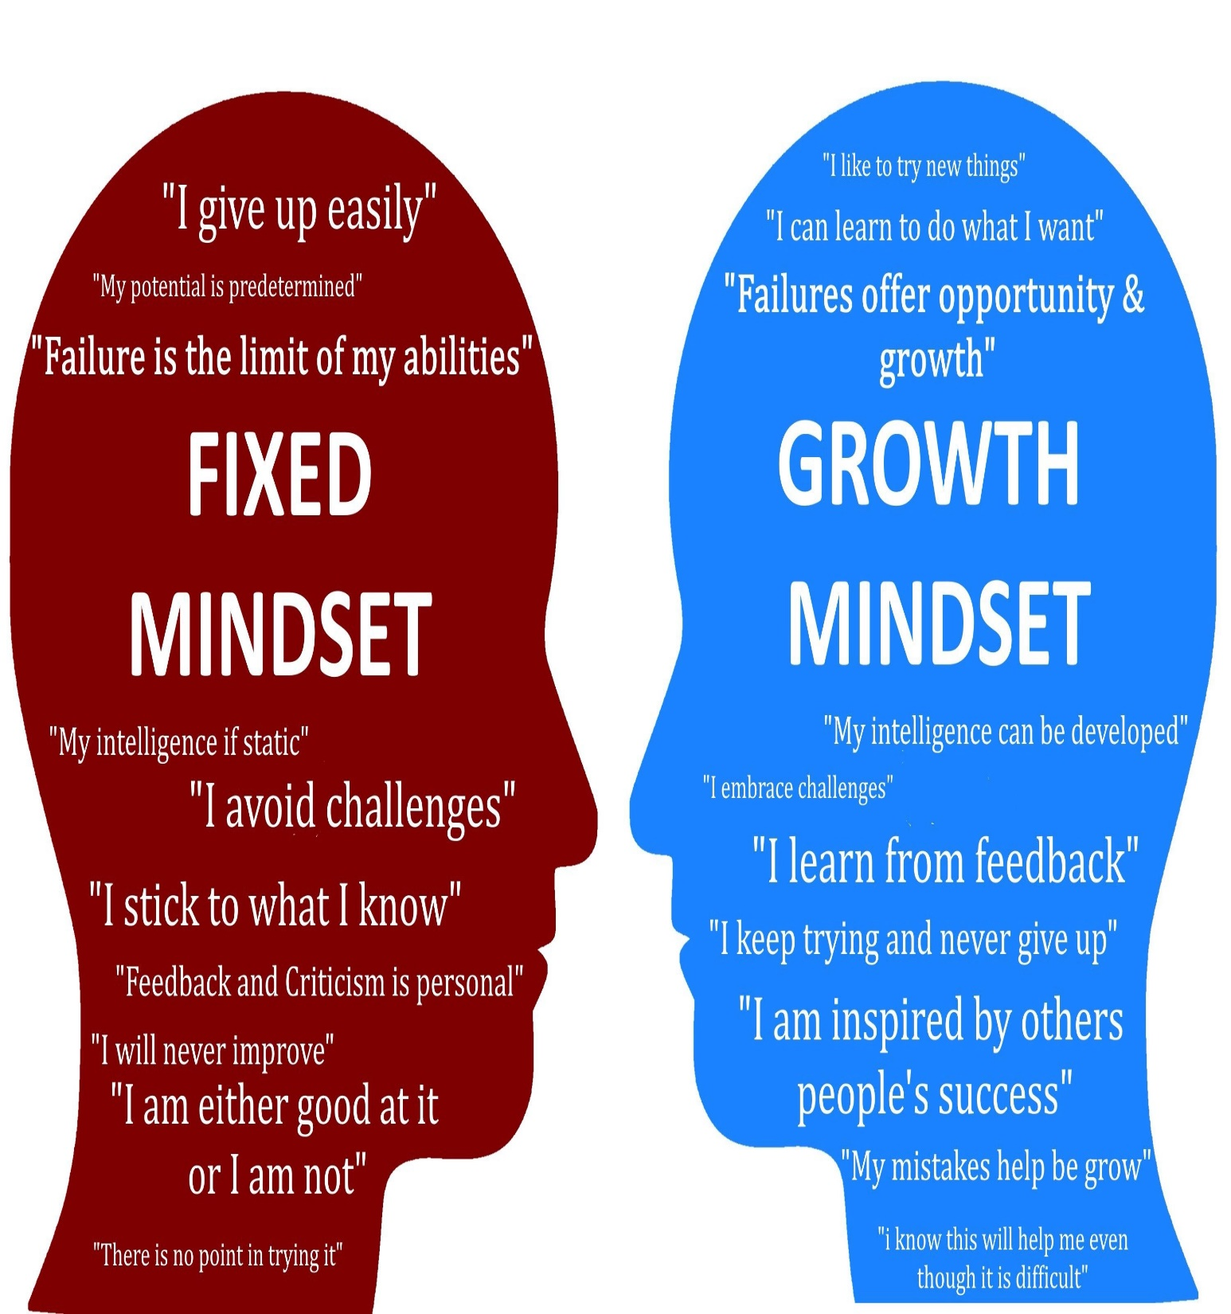
Radical Growth Mindset
Become smarter as actively learn through challenges, struggles, mistakes.
Trust learning happens through dialogic engagement.
Mistakes are not immutable flaws.
Helps see past what did or said because committed to self-development.
Makes defensiveness and deflection more concerning than initial situation.
Kind accountability to self is key.
We are always on the way…
(Ravitch, 2020)

Slide 18
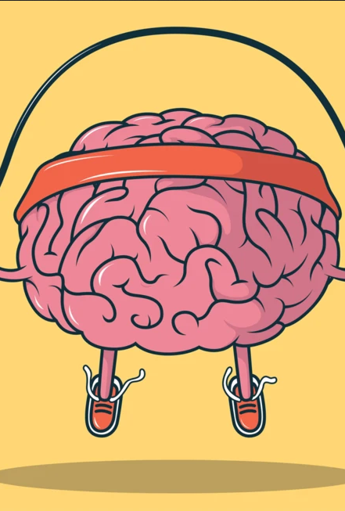
Radical Growth Mindset
Active growth orientation to transformational self-learning.
Learning into implicit biases and deficit-based beliefs and their role in perception, communication, decisions.
Self-reinforcing—growth happens when seek out and reckon with challenging perspectives, which helps us face challenges knowing that learning includes missteps, vulnerability, being challenged and critiqued.
Serves to decentralize problematic knowledge and social capital hierarchies.
Creates opportunities to hybridize knowledge.
(Ravitch, 2020)

